Slide 1
Bee Vectoring Technologies
March 23, 2023
CSE: BEE OTCQB: BEVVF
Ashish Malik, CEO

Slide 2
Forward Looking Statement
This presentation contains certain forward-looking statements that may involve a number of risks and uncertainties. Actual events or results could differ materially from Bee Vectoring Technology (“BeeVT”, or, the “Company”) expectations and projections. The CSE has neither approved nor disapproved the information contained in this presentation. Except for statements of historical fact relating to the Company, certain information contained herein constitutes "forward-looking statements". Forward-looking statements are frequently characterized by words such as "plan", "expect", "project", "intend", "believe", "anticipate" and other similar words, or statements that certain events or conditions "may" or "will" occur. Forward-looking statements are based on the opinions and estimates of management at the date the statements are made and are subject to a variety of risks and uncertainties and other factors that could cause actual events or results to differ materially from those projected in the forward-looking statements. These factors include the inherent risks involved in the development of biotechnology related products, product obsolescence, the uncertainties involved in patent defense and complexities and timelines associated with agriculture related product approvals in multiple jurisdictions., the possibility of project cost overruns or unanticipated costs and expenses, uncertainties relating to the availability and costs of financing needed in the future and other factors. Circumstances or management's estimates or opinions could change. The reader is cautioned not to place undue reliance on forward-looking statements.

Slide 3
Agenda
1
Market Context
Technology & Value Proposition
BVT Strategy
2023 Progress
Investment Window
2
3
4
5

Slide 4
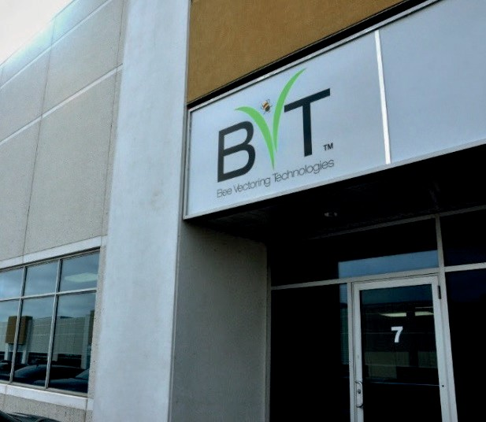
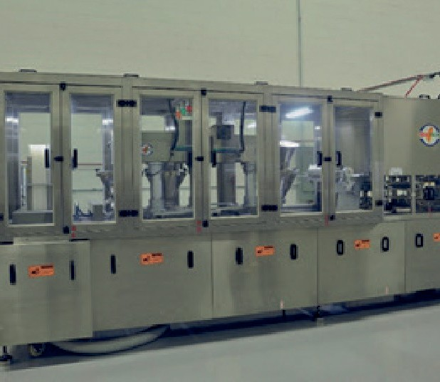
Bee Vectoring Technologies (BVT)
BVT’s Natural Precision Agriculture system replaces chemical pesticides by delivering simple and validated biological alternatives using commercially grown bees, seed treatment and other delivery methods.
A proven, environmentally friendly solution for growers
Increases crop yields and profitability No chemicals or GMOs
No water or fossil fuels
Growing business momentum
Platform technology
High quality and diverse revenue stream Strong and protected IP
Ongoing business expansion
New product applications Advancing into global markets Partnerships

Slide 5
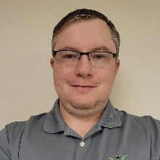
BVT Team: World Class Experience In Crop Protection, Big Agriculture, Start-up Launch to Exit, and a Deep Industry Network
MANAGEMENT
Ashish Malik
Director, President and CEO
Bayer CropScience, Syngenta, AgraQuest (acquired by Bayer
For US$425mio)
Christoph Lehnen
Business Manager, Europe
Biological product portfolio leader at Syngenta (30+ yrs overall experience)
Ian Collinson
Sales Manager
8+ years with BVT, key relationships with ag industry partners, suppliers, and growers
Sherri Tedford
Technical & Regulatory Manager
10+ years in integrated pest management & biocontrol research
Mason Newark
Field Technical Manager
Experienced product development specialist in ag industry; PhD plant pathology Univ of Florida
ADVISORY
Dr. John Sutton
Scientific Advisor
Internationally recognized expert on plant pathology; experience
throughout North and South America
Michael Collinson
Chairman
BVT CEO from 2012 - 2016; 35 years in international manufacturing, sales and marketing leadership
James Molyneux
Director & Corporate Secretary
30 years with public and private companies; partner with MNP Assurance

Slide 6
Imagine an Agricultural Productivity Technology that…
Significantly increases profitability for farmers
Yield increases upwards of 30% and a more consumer-friendly crop
Uses no chemicals or GMOs
Safe for consumers, workers, environment
Uses no water
Increases sustainable farming: Ag is the biggest user of fresh water
Uses no fossil fuels
Reduces climate change: Ag contributes 12% of global greenhouse gas emissions

Slide 7
Imagine an Agricultural Productivity Technology that…
Significantly increases profitability for farmers
Yield increases upwards of 30% and a more consumer-friendly crop
Uses no chemicals
Safe for consumers, workers, environment
No need to Imagine
Uses no water
Increases sustainable farming:
Ag is the biggest user of fresh water
This exists today
2012: Company founded
2015: BVT goes public
2020: First revenue
2021: First industry partnership
2022: Started expansions
Uses no fossil fuels
Reduces climate change:
Ag contributes 12% of global greenhouse gas emissions

Slide 8
BVT is the Only Company that Combines Two Unique Technologies
Biological crop treatment
(an Alternative to Chemicals)
&
Delivery by bees
(an Alternative to Spraying)
Biological Control Agents
2 Dispenser Systems
Clonostachys rosea Strain BVT CR-7
1st product approved for application using bees by EPA
VectorHive™ Bumble Bee System
Beauveria bassiana spp (various strains)
BVT has several discussions with partner companies
Several other microbial strains
BVT has several discussions with partner companies
VectorHive™ Honey Bee Dispenser
65+ patents covering 5 technology areas

Slide 9
BVT Delivers Compelling Value to Growers
BVT
Traditional Spray
30% higher yields and 98% less chemicals
Precision delivery: use grams NOT kilograms
Natural: biologicals NOT chemicals
Sustainable: natural process NOT using water and fossil fuels
Profitable: higher yields, better quality and shelf life, in demand from consumers
Vs.
20 grams / acre
(biological)
4 kilograms / acre
(pesticide)
* Amount of BVT CR-7 used in 2 hives per acre with Vectorite with CR-7 trays replaced every 5 days vs. 10 sprays of Switch fungicide at rate of 14 oz/ac.

Slide 10
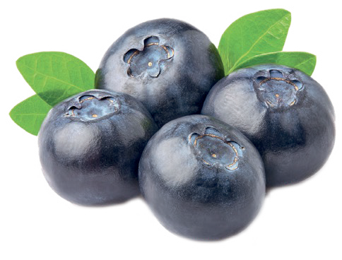
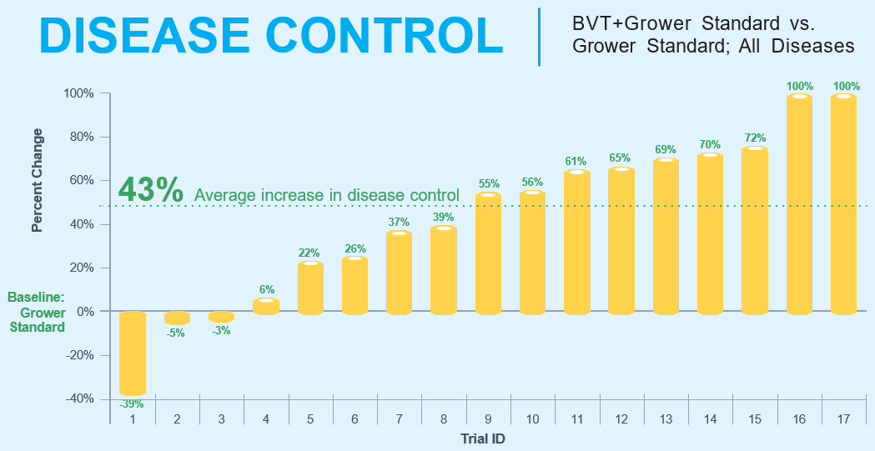
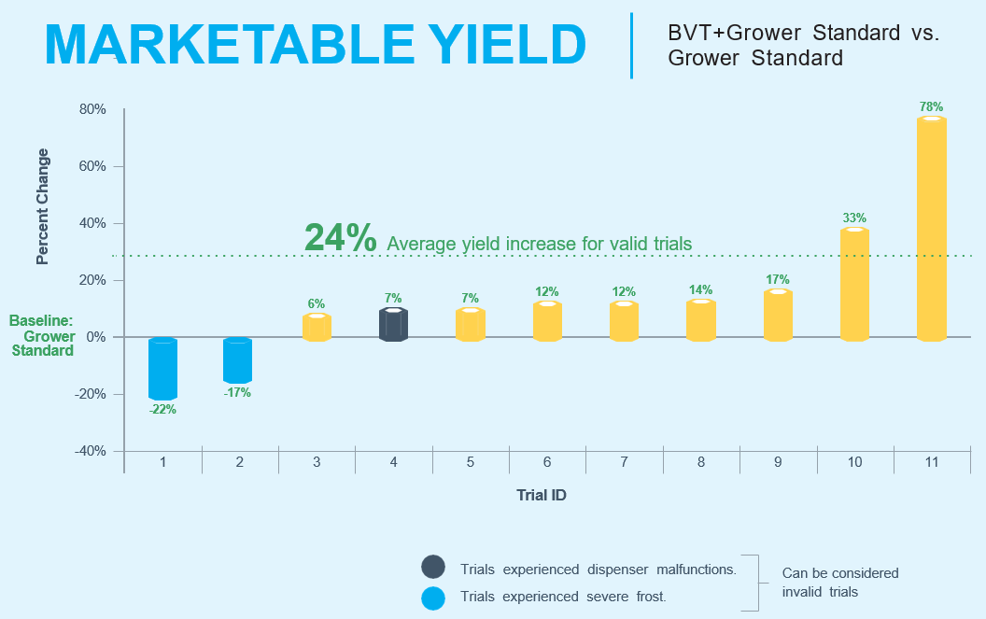
Blueberry Trials – Across Diverse Markets
Trials are from 2017 to 2022
Trials include bumblebees and honeybees
Trials were conducted in the United States, Canada, Mexico, and Europe

Slide 11
BVT is Developing 4 Market Segments
Bumble Bee Vectoring
Honeybee
Vectoring
CR-7 for Foliar/Drench
CR-7 for Seed Treatment
Gives access to wide diversity of indoor and outdoor crops
BVT is commercial with both systems in USA using BVT CR-7
BVT has started geographic expansions
Developing solutions based on other biological strains to control additional pests
Broad spectrum biological fungicide
Ideal product for “low/no chemical” spray programs (incl. for European Green Deal)
Combination yield enhancer and disease control
Have positive results in soybeans which is driving partner interest
Through Partners

Slide 12
BVT has Earned the Right to Play
Biological Control Agents
Targeted Applications that Replace Chemicals
Foliar
Clonostachys rosea
Proprietary Microbe:
BVT CR-7
Soil-Applied
Seed treatment
USA
In-licensed biological strains
Beauveria bassiana
ATCC 74040
Bee Vectoring Systems
(honeybees & bumble bees)
Other biological strains
Strains 1, 2, x

Slide 13
BVT’s Unique Platform Provides Multiple Revenue Streams
Biological Control Agents
Targeted Applications that Replace Chemicals
Foliar
Clonostachys rosea
Proprietary Microbe:
BVT CR-7
Soil-Applied
Seed treatment
Geographic Expansions
In-licensed biological strains
Beauveria bassiana
ATCC 74040
Bee Vectoring Systems
(honeybees & bumble bees)
Other biological strains
Strains 1, 2, x

Slide 14
BVT’s Unique Platform Provides Multiple Revenue Streams
Biological Control Agents
Targeted Applications that Replace Chemicals
Foliar
Clonostachys rosea
Proprietary Microbe:
BVT CR-7
Soil-Applied
Seed treatment
In-licensed biological strains
Beauveria bassiana
ATCC 74040
Bee Vectoring Systems
(honeybees & bumble bees)
Other biological strains
Strains 1, 2, x
Other Products for Bee Vectoring

Slide 15
BVT’s Unique Platform Provides Multiple Revenue Streams
Biological Control Agents
Targeted Applications that Replace Chemicals
New Markets for CR-7
Foliar
Clonostachys rosea
Proprietary Microbe:
BVT CR-7
Soil-Applied
Seed treatment
In-licensed biological strains
Beauveria bassiana
ATCC 74040
Bee Vectoring Systems
(honeybees & bumble bees)
Other biological strains
Strains 1, 2, x

Slide 16
Commercialization in the US
BVT Target Market
CAD $4.3 Billion
1
Commercialization in the US
Well underway: Have proven BVT fit in large-scale commercial agriculture
$ 250 million
2012 – 2023: Built Solid Foundation to Fuel Growth
Patents, Registration, Technical Validation, Commercial Success, First Partnerships
Notes:
Alt title suggestion: Solid Platform for Accelerating Growth

Slide 17
FY2021: Significant Progress in 2021
+47%
Revenue growth (in USD)
~40
Customers overall
100%
Customer retention in Georgia
Opened 6
New markets
California started opening up
Natural Precision Agriculture

Slide 18
FY2022: Continued High Growth
Significant Growth in New Markets Growth Despite External Challenges in Georgia
Supply Chain Constraints
+78%
First revenues in California
428% growth in the Pacific Northwest
46% growth in the Midwest and Northeast
Newer
Markets
+25%
Overall Revenue Growth (in USD)
+4%
Severe freeze events pre- and during bloom leading to crop losses
Skyrocketing fertilizer prices - growers had less money to spend on other inputs
Georgia
Blueberries
12-month lead times on electronic components limits the number of new dispensers for 2023 season
Supply
Chain
Natural Precision Agriculture

Slide 19
2022 Commercial Grower Trials – Pacific Northwest
BVT treated berries were consistently larger and heavier than the grower standard alone.
Berry Size Distribution for All Sites
BVT + Grower Standard
Berry Weight Distribution for All Sites
BVT + Grower Standard Grower Standard
Grower Standard
35%
30%
25%
20%
15%
10%
5%
0
BVT produces bigger berries
40%
BVT produces heavier berries
Berry Frequency
Berry Frequency
MORE JUMBO PACKS
30%
20%
10%
12
13
14 15 16 17
Berry Size in MM
18
19
20
21
22
0
<1.2g
1.2-1.4g 1.5-1.7g 1.8-2.0g 2.1-2.3g 2.4-2.6g 2.7-2.9g
Weight
>3.0g
AVERAGE OF
1.26mm Larger
Diameter Berries
BVT + Grower Standard:
18.36mm
average
Grower Standard alone:
17.20mm
average
AVERAGE OF
26.67%
Heavier Berries
BVT + Grower Standard:
2.25 grams average
Grower Standard alone:
1.78 grams average
Natural Precision Agriculture

Slide 20
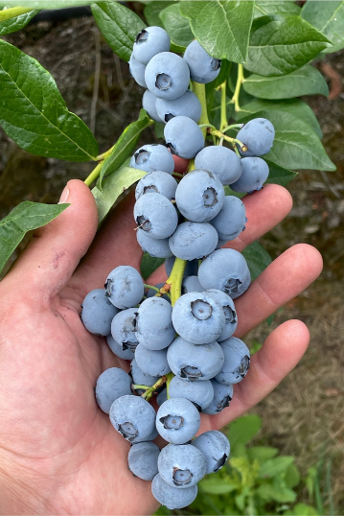
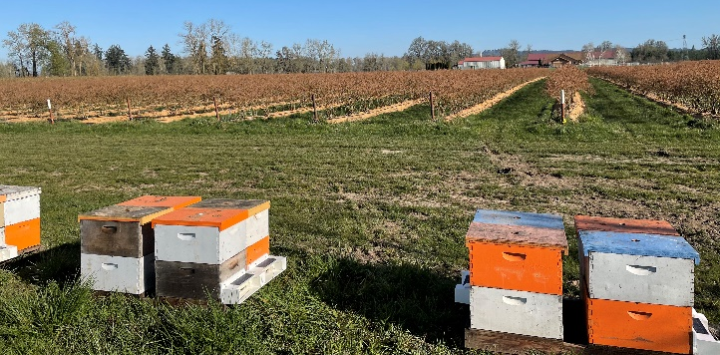
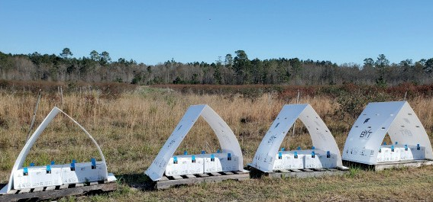
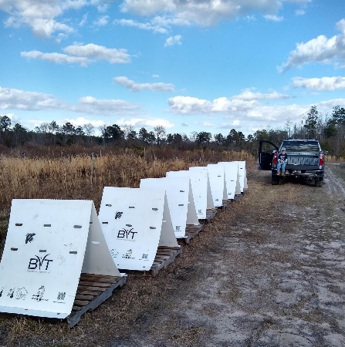
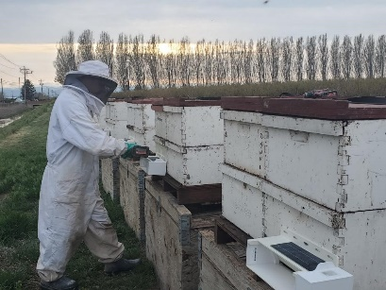
2023 Growth / Pipeline
Continued Momentum on Sales Growth
Retention Customers are coming back for repeat purchase
New Markets California blueberries; major areas in the Pacific Northwest
New Key Customers Large key growers are asking about BVT, and we expect some will start using this season
New Applications Foliar/Soil-applied; targeting first revenue into this market in 2023 season through BioSafe partnership
Natural Precision Agriculture

Slide 21
Geographic Expansion
BVT Target Market
CAD $4.3 Billion
1
Commercialization in the US
Well underway: Have proven BVT fit in large-scale commercial agriculture
$ 250 million
REPLICATE SUCCESS
2
Geographic Expansion
Started expansions using know-how from the US
$ 700 million
2012 – 2023: Built Solid Foundation to Fuel Growth
Patents, Registration, Technical Validation, Commercial Success, First Partnerships
Notes:
Alt title suggestion: Solid Platform for Accelerating Growth

Slide 22
2023 Update: BVT-led Expansions
2023 Update
Next Steps
Mexico
Official submission made April 2022
Mexican authorities have experienced delays and timelines are hard to predict
Peru
In contact with SENASA
Import permit approval of trials plan secured
Submission made following pre-submission consultation and completion of 2 additional studies
Canada
Official submission made Dec 2022
Consultants preparing submission strategy for 2-step process; large backlog with member states for biological submissions
Pre-submission consultations with authorities completed – Preparing dossier for active substance approval for 2023 submission
EU
Switzerland
Delays in reorganization in ministries; additional efficacy data requested (done); have asked for genetic level info on CR-7
Genetic work being done with experts in the genus and species of our strain
Notes:
Alt title suggestion: Solid Platform for Accelerating Growth

Slide 23
2023 Update: Partner-Enabled Expansions
2023 Update
Next Steps
Turkey
MoU signed; Partner pursuing approval for initial trials that are first step in regulatory process
Official trials once protocol is approved by regulators
Morocco
Visit to Moroccan authorities completed
Finalize terms for distribution agreement and business plan
Israel
Completed application for import permit to conduct trials
Trials
South Africa
Preliminary business evaluation
Trials being planned by partner
Notes:
Alt title suggestion: Solid Platform for Accelerating Growth

Slide 24
Portfolio Expansion and Extensions
BVT Target Market
CAD $4.3 Billion
1
Commercialization in the US
Well underway: Have proven BVT fit in large-scale commercial agriculture
$ 250 million
REPLICATE SUCCESS
LEVERAGE ASSETS
2
Geographic Expansion
Started expansions using know-how from the US
$ 700 million
3
Portfolio Expansion & Extensions
CR-7 for new markets/applications;
More products through BVT dispensers
$ 3,350 million
2012 – 2023: Built Solid Foundation to Fuel Growth
Patents, Registration, Technical Validation, Commercial Success, First Partnerships
Notes:
Alt title suggestion: Solid Platform for Accelerating Growth

Slide 25
BVT CR-7 (Clonostachys rosea Strain CR-7)
A unique and beneficial endophytic fungus
Where it’s found
Sub-arctic to humid tropics
Found in numerous soils (agricultural, forest, natural…)
Associates with an extraordinarily wide array of plant species
Selected from 1400 fungal isolates
Rapid reproduction Stability in the field Spore size and
commercialization
Characteristics
Remains protected while inside the tissue throughout the growing season
Remains stable in temperate climates
Useful tool for crop production
Mode of Action:
Competitive exclusion
Plant growth promotion
Mycoparasitism of pathogens
Natural Precision Agriculture

Slide 26
CR-7: Useful Tool for Resistance Management
Pathogens develop resistance to fungicides
Similar to bacteria developing resistance to certain antibiotics
FUNGICIDE RESISTANCE ACTION COMMITTEE (FRAC)
BM: Biologicals with Multiple Modes of Action
BM 01: plant extract
BM 02: microbial
(strains of living microbes or extract, metabolites)
Resistance management of crop protection products is very important
Polypeptide (lectin)
Fungal Trichoderma spp.
Fungal Clonostachys spp.
Bacterial Bacillus spp.
Bacterial Erwinia spp. (peptide)
Breaking resistance in pathogens means preservation of diverse tools for growers
Phenols, Sesquiterpenes, Triterpenoids, Coumarins
Fungal Coniothyrium spp.
Fungal Hanseniaspora spp.
Bacterial Pseudomonas spp.
Bacterial Gluconobacter spp.
CR-7’s mode of action has been accepted by the FRAC (Fungicide Resistance Action Committee) under Group BM-02
Terpene Hydrocarbons, Terpene alcohols and Terpene phenols
Fungal Saccharomyces spp.
Fungal Talaromyces spp.
Bacterial Streptomyces spp.
Gives credibility over many other biological products which are not characterized
Group BM01
Group BM02
Common names are described in FRAC code list
Natural Precision Agriculture

Slide 27
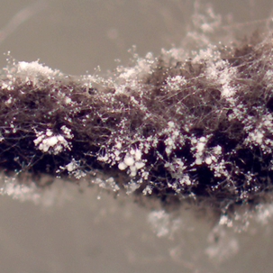
Activity of CR-7 on Crop-Pest Combinations
Characterizing CR-7 Enables Partnering Discussions
CROPS TESTED IN 2022 STUDY |  |  |  |  | CROPS TESTED IN PREVIOUS STUDIES
Tomato | Zucchini / cucumber | Potato | Grape | Lettuce | Greens | French beans, peas | Rape seed / canola | Blueberry* | Strawberry* | Sunflower* | Almond / stone fruit*
Early Blight | Powdery Mildew*** | Damping off | Powdery Mildew | Pythium Wilt | Downy mildew (Basil) | White mold* | White mold | Grey Mold | Grey Mold | Sclerotinia head blight | Jacket Rot
Late Blight | Anthracnose | Black Scurf | Grey Mold** |  | Downy mildew (Parsley, Coriander) | Aphanomyces root rot |  | Anthracnose Fruit Rot | Anthracnose Fruit Rot** |  | Brown Rot Blossom Blight
Anthracnose | Downy mildew |  | Downy mildew |  |  |  |  | Alternaria
Grey Mold** |  |  |  |  |  |  |  | Brown Rot
No activity compared to untreated check
Significant activity compared to untreated check, no meaningful dose response
Significant activity compared to untreated check, visible dose response
* Prediction based on previously completed bee vector studies
** Prediction based on same agent in different crop
*** One trial showed slight control
2022 work characterizing CR-7 validated it as a broad spectrum biofungicide across many crops This enables discussions with potential partners for foliar/soil-applied uses
The first partnership for BVT is with BioSafe
2023 launch; with further developments being planned
Arrangement is non-exclusive allowing BVT to pursue other partnerships

Slide 28
2023 Update: Foliar/Soil-Drench
Market Opportunity
BVT Plan
Market size: Fungicide market is CAD $20 billion worldwide
Fruit & Veg > CAD $8 billion
Chemical fungicides continue to be replaced by biologicals
Biological fungicide market: CAD $1.5 billion, growing at 15% CAGR
Traditional Ag Chem companies need alternatives for their existing product portfolios
Known control of necrotrophic pathogens through work done for bee vectoring of CR-7
Signed agreement with BioSafe
Next Steps
Complete spectrum of control “heat map” (2022)
Present findings to partners
Develop sprayable formulation
Revenue opportunity: CAD $2 billion (global)
BVT revenue target: CAD $20 million ($5-10 million in USA)
Natural Precision Agriculture

Slide 29
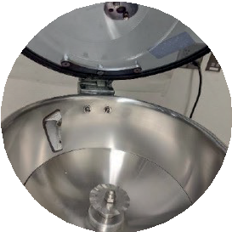
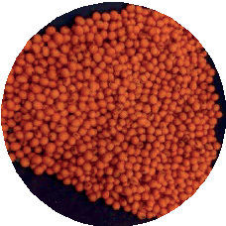
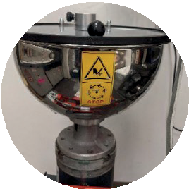
Seed Treatment: Field Performance Program
Objective: To evaluate field performance of CR-7 in treated soybeans across multiple seasons
2 Product concepts:
Together with or instead of bacterial inoculants
Suppression/control of Fusarium virguliforme (SDS)
7 Treatments:
Base seed treatment (BST = 5 products incl. 2 other biologicals)
BST + 2 rates of CR-7
BST with 2 standards (biological and chemical) for SDS
BST with no biologicals + 2 rates of CR-7
Locations: use major soybean growing regions (3 in 2021, 4 in 2022)
9 different data sets collected
In partnership with Agrithority: leading product development firm with global expertise
Seeds treated at SGS, SD for all trials
Seed treater inside
Treated seed
Seed treater outside
Natural Precision Agriculture

Slide 30
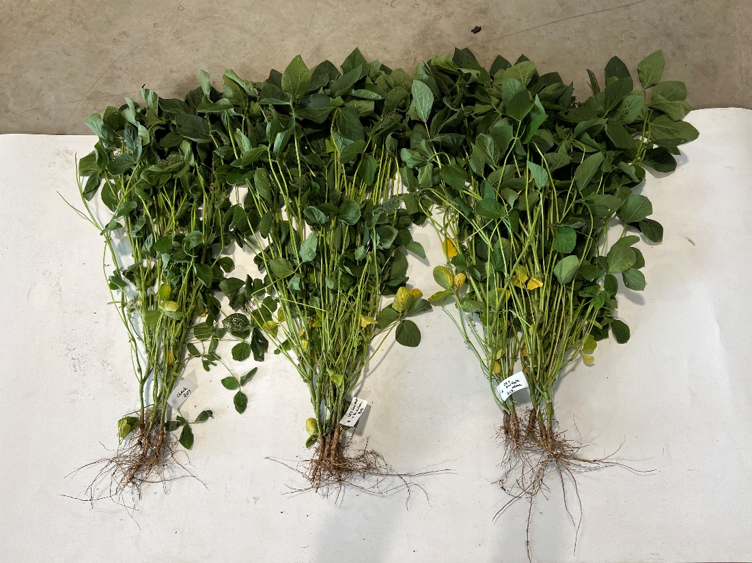
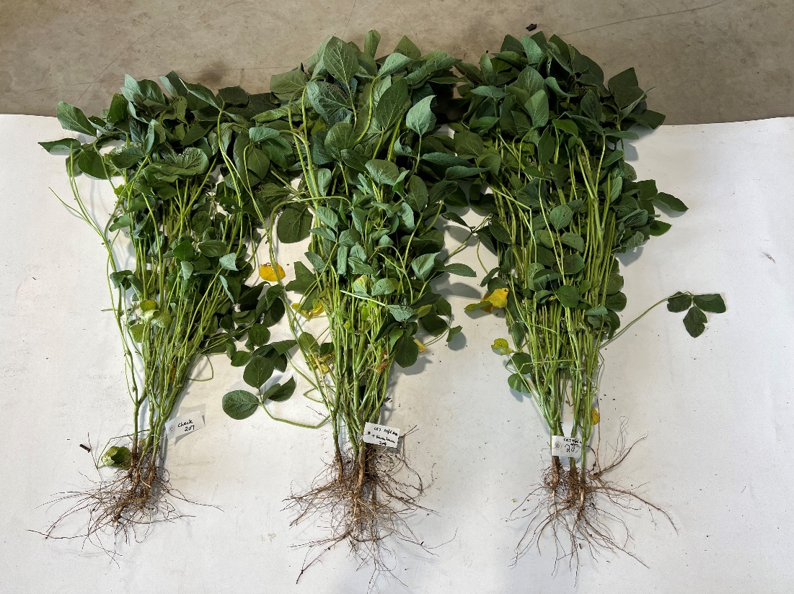
Increased Root/Shoot Mass and Nodulation Walnut, IL 2022 Trial
Effect of CR-7 Low Rate
Effect of CR-7 High Rate
T1
BST
T2
BST
+ CR7 low rate
T6
BST
+ CR7 low rate
- Optimize/Jumpstart
T1
BST
T3
BST
+ CR7 high rate
T7
BST
+ CR7 high rate
- Optimize/Jumpstart
Natural Precision Agriculture

Slide 31
Yield – 2022 Trials
CR-7 (low rate) Increases Yield Over BST
CR-7 low rate + BST vs. BST
CR-7 (high rate) Increases Yield Over BST
CR-7 high rate + BST vs. BST
12
12
10
10
Bushels Differences per acre
8.0
Bushels Differences per acre
8.0
6.0
6.0
4.0
4.0
2.0
2.0
0.0
0.0
-2.0
-4.0
-2.0
-6.0
-4.0
Calculated difference between BST and BST + CR-7 at 0.80 oz/100 lb seed. No statistics were performed. Win rate was calculated by dividing all positive replicates by the total number of replicates. Bushel gain was calculated taking the total average of all replicates.
-8.0
Calculated difference between BST and BST + CR-7 at 0.16 oz/100 lb seed. No statistics were performed. Win rate was calculated by dividing all positive replicates by the total number of replicates. Bushel gain was calculated taking the total average of all replicates.
69% win-rate; +3 more bushels per acre
81% win-rate; +2.8 more bushels per acre
Natural Precision Agriculture

Slide 32
2023 Update: Soybean Seed Treatment
Market Opportunity
BVT Plan
320 million acres worldwide
85 million acres USA: 80% get seed treatment; 50% inoculated
100 million acres Brazil & 40 million acres Argentina (~70% inoculated)
Distinct market segments: Upstream (seed companies) & Downstream (retailers and on-farm)
Players are looking for added yields and differentiation
2021-22 field trials (with tech grade product) confirm:
BVT CR-7 increases above ground and below ground plant biomass when added to, or instead of, soybean inoculants
BVT CR-7 provides equivalent control of SDS to current chemical and biological standards
Next Steps
Continue 2nd season trials (2022)
Generate seed safety and stability data (ongoing)
Present findings to partners
Develop seed treatment formulation
Revenue opportunity: CAD $850 million (global)
BVT revenue target: CAD $20 million ($7 million in USA @ 75%+ margin)
Natural Precision Agriculture

Slide 33
A Compelling Investment Window
2025 Valuation Based on multiple revenue streams
BVT CR-7 through BVT bee delivery systems in USA
BVT CR-7 through BVT bee delivery systems in up to 5 new geographies
2023 Valuation Based on technology being de-risked & the initial revenue stream
Third-party products through BVT systems
BVT CR-7 in broad-acres crops (soybeans) through seed treatment application
BVT CR-7 through BVT bee delivery systems in USA
BVT CR-7 as a foliar/soil-applied biological fungicide
Natural Precision Agriculture
33

Slide 34
BVT is Aligned with Disruptors in the Agriculture Industry
Acquirer | Description | Target | Who they were | Revenues Pre-Acquisition | Acquisition Price | Date
Bayer | Big-4 global MNC | Agraquest | Leading biopesticides provider | $17M | $425M + milestones | July 2012
LeSaffre | Leading global fermentation company (yeasts etc) | Advanced Biological Marketing (ABM) | US seed treatment specialist | N/A | N/A | May 2021
Bioline (InVivo Group) | €10B French Ag cooperative buying biological assets | Dudutech | Leading biologicals provider in Africa | N/A | N/A | March 2021
Syngenta | Big-4 global MNC | Valagro | Leading biostimulants company | $175M | N/A | October 2020
Nutrien | Leading global fertilizer, distributor/retailer of crop inputs | Actagro | Soil & plant health products provider | N/A | $340M | February 2019
Biobest | Leading biologicals company (incl. pollinators) | IVOG | Traps and rolls for biological controls | N/A | N/A | January 2018
Corteva | Big-4 global MNC (Merged Dow & DuPont entity) | Taxon Biosciences | Early-stage seed and crop protection | 0 (pre-revenue) | N/A | May 2015
Valent | Sumitomo Chemical: Top-10 global player | Mycorrhizal Applications | Provider of soil fungi for plant health | N/A | N/A | March 2015
Koppert | Leading biologicals company (incl. pollinators) | Manejo Agricola | Distributor of biologicals for row crops in Brazil | N/A | N/A | February 2014
Monsanto | Big-4 global MNC (now part of Bayer) | Novozymes | Leading microbial / enzymes global player | JV | $300M | December 2013
Syngenta | Big-4 global MNC | Pastueria | Specialist in biological nematicides | < $1M | $86M + $27M deferred | September 2012
BASF | Big-4 global MNC | Becker Underwood | Leading seed treatment products | $200M | $1B | September 2012
Natural Precision Agriculture

Slide 35
An Attractive and Relevant Partner to Big-Ag
Possible Exit via Strategic Partner BVT is becoming attractive and relevant to Big-Ag
Established players need environmentally responsible solutions in their mix
BVT has 15 ongoing partnership discussions, including with Global Multinationals
BVT has strong and defensible IP (patents, registrations, unique know-how)
Multi-crop; multi-market validation
Natural Precision Agriculture
35

Slide 36
Moving From Right to Play → Right to Win
BVT in 2023
Proven low / no-impact solutions that increase crop yields
30% higher yields and 98% reduction in chemicals; no use of water or fossil fuels
High quality, validated, revenue mix
US EPA registered; 47% revenue growth in 2021; doubled sales in new markets (outside Georgia) in 2022
Platform technologies with multiple revenue streams
Multiple revenue streams through biological products with bee vectoring and partnerships with global leaders
Global, multi-crop opportunities
70+ trials in 6 countries on multiple crops
Strong and protected IP
65+ granted worldwide patents across 5 families of technology; 35+ pending patents

Slide 37
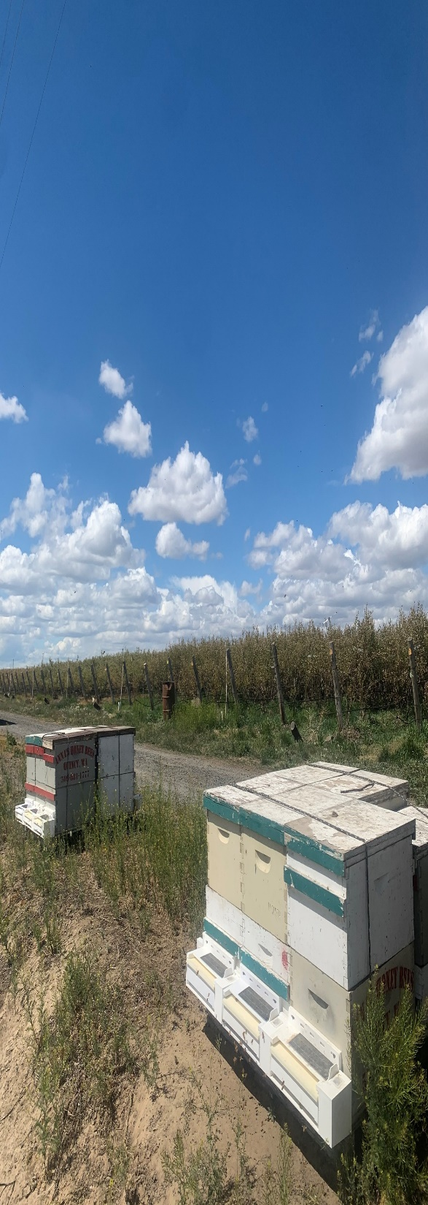
BEE VECTORING TECHNOLOGIES
CSE:BEE OTCQB:BEVVF
Thank you.
For additional information, contact:
Ashish Malik, CEO
BVT
amalik@beevt.com
Virtus Advisory Group (Canada & International) Babak Pedram, Investor Relations
(416) 644-5081 | info@virtusadvisory.com
RB Milestone Group (USA)
Will Maze, Investor Relations
(203) 487-2759 | bee@rbmilestone.com

